Slide 1




Enhanced Data Analytics: Integrating NVIDIA Rapids cuGraph with TigerGraph
Dan McCreary
Head of AI
© 2024 ALL RIGHTS RESERVED | TIGERGRAPH.COM
‹#›

Slide 2


— Jeff Hawkins on AI
Jeff Hawkins on AI
The key to artificial intelligence has always
been the representation.

Slide 3

Sample Challenge: Banking Transaction Fraud
Have you ever wondered what happens when you use your credit card at a retailer?
The authorization usually is returned in just a few seconds (Service Level)
Did you know that many banks execute tens of thousands of checks for each transactions to make sure the transaction is not fraudulent?
But are these checks enough?

Slide 4
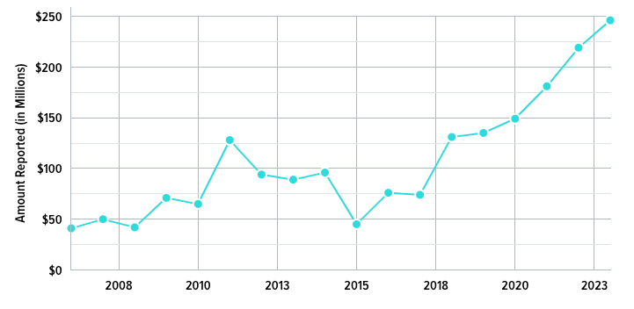
Credit Card Fraud Continues to Grow
According to WalletHub, the total worldwide credit card fraud rates continue to rise every year.
Annual global fraud losses (credit & debit card): $34.36 billion (2022)
The total value of fraud in the US soared to $246 million in 2023, signifying a substantial 12% rise from the previous year.
https://wallethub.com/edu/cc/credit-card-fraud-statistics/25725

Slide 5
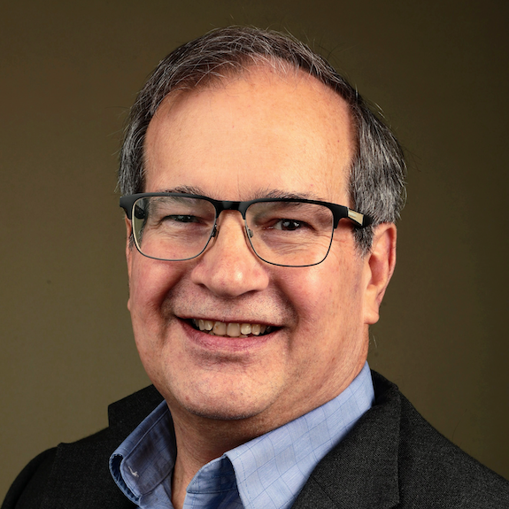
Introduction
Dan McCreary
Head of AI for TigerGraph
TigerGraph is a market leader in scale-out enterprise graph databases
We combine LLMs with scale-out graph representations of the world
Large market share of financial institutions doing fraud detection and anti-money laundering
Proponent of “Hardware Optimized Graph” (HOG)

Slide 6
The “Big Four” Representations in AI Today
IMAGE AND VIDEO
SEQUENCES
TABULAR
GRAPH
?
Which is most similar to the brain?

Slide 7

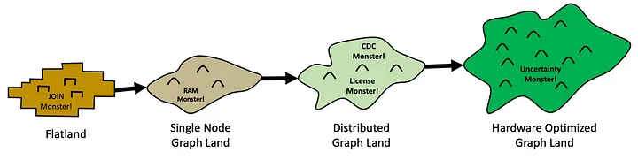
Our Journey: Hardware Optimized Graph
(HOG Heaven)
https://towardsdatascience.com/from-flatland-to-hog-heaven-the-four-lands-of-ekg-adoption-945571c09b67

Slide 8
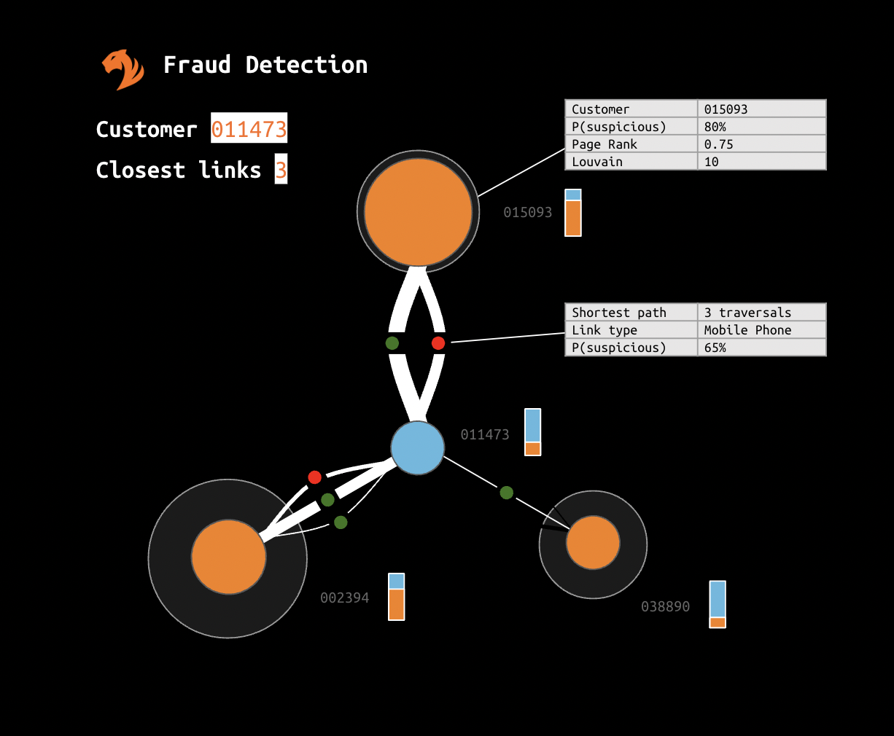
Background on Graph Acceleration
Many companies have requirements for mission critical real-time graph algorithms.
Example: is this credit-card transaction fraudulent?
Example: Is this transaction part of a money laundering scheme?
Service Level Agreements (SLAs) need to allow algorithms to run in under 100 milliseconds
Most CPUs don’t offer enough parallelism to execute complex graph algorithms within this SLA window

Slide 9
Some Terms
GPU - Graphics Processing Unit - optimized for matrix manipulation - they typically come with thousands of cores that run in parallel
UDF - User defined functions - C level functions compiled into the TigerGraph runtime
HBM - High Bandwidth Memory - memory tightly coupled with GPUs for low latency access
CUDA - NVIDIA C-language application interface to communicate with GPU
RAPIDS - an open source Python library for using GPUs http://rapids.ai/
cuGraph - An NVIDIA open source collection of GPU accelerated graph algorithms and graph utility functions that are designed to work with Python libraries such as NetworkX
NVIDIA RAPIDS - libraries for accelerating the flow of data between CPU and NVIDIA GPUs
Sparse matrix - a matrix where most of the values in the matrix are zero - most graph problems have an sparse adjacency matrix

Slide 10
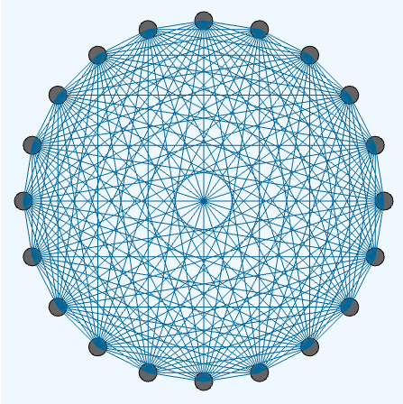
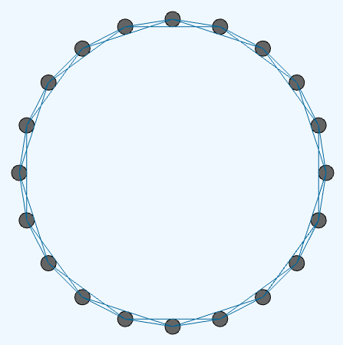
Dense and Sparse Matrix Representation
DENSE NETWORK
SPARSE NETWORK
GPUs are ideal for dense matrix problems
Everything is connected to everything
Few connections per node (low degree)

Slide 11
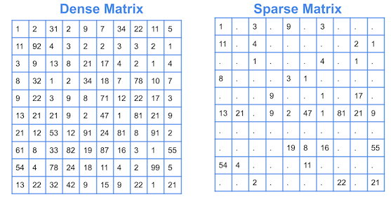
Dense vs Sparse Matrix

Slide 12
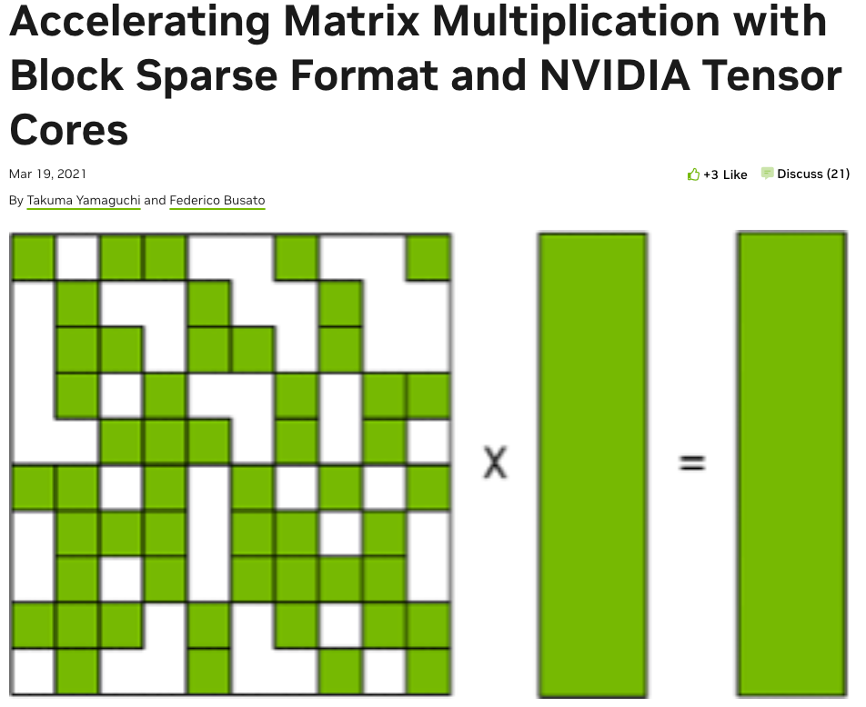
NVIDIA Library for Sparse Matrix Representations (March 2021)
https://developer.nvidia.com/blog/accelerating-matrix-multiplication-with-block-sparse-format-and-nvidia-tensor-cores/

Slide 13
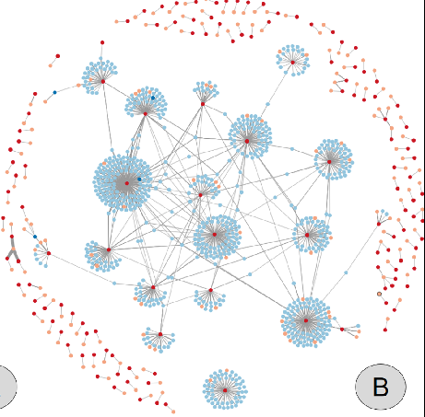
Solution!
Leverage the massive parallelism of both TigerGraph + NVIDIA GPUs to analyze complex networks in real-time with cuGraph

Slide 14




Accelerating TigerGraph for Enhanced Analytics
Performance Enhancement: Accelerating TigerGraph improves processing speed and efficiency for timely insights.
Scalability: Acceleration enables TigerGraph to handle larger and more complex datasets seamlessly.
Competitive Advantage: Faster insights from accelerated TigerGraph drive business success in a data-driven landscape.
Enabling Advanced Applications: Accelerating TigerGraph unlocks the potential of cutting-edge technologies like graph-based machine learning and AI-driven analytics.

Slide 15
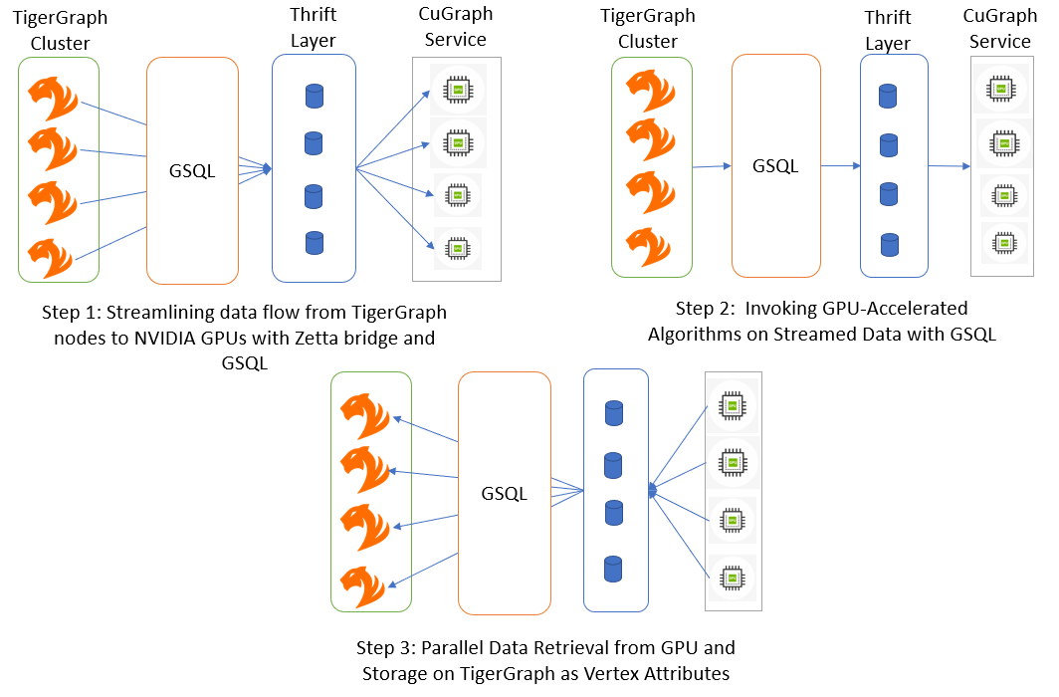
Initial Approach - TigerGraph integration with cuGraph via Python APIs
STEP 1
STEP 3
STEP 2

Slide 16
Evolution from Python
to Native C++ cuGraph Integration
CHALLENGES WITH THE PREVIOUS ARCHITECTURE:
IMPLICATIONS FOR SETUP AND PERFORMANCE:
NEXT-GENERATION ARCHITECTURE:
Dependency on Disk: We are using disk based data transfer between TigerGraph and cuGraph.
Python Dependency: Utilizing Python for cuGraph introduced overhead and complexity, impacting performance.
Thrift Layer : Thrift communication added complexity and overhead, potentially affecting system reliability.
Complex setup process hindered optimal performance.
Shared disk, Python, and Thrift dependencies created scalability challenges.
Designed to overcome limitations of the previous architecture.
Revolutionizes graph processing for enhanced scalability and performance.
Explores new frontiers in graph analytics through native C++ cuGraph integration.

Slide 17
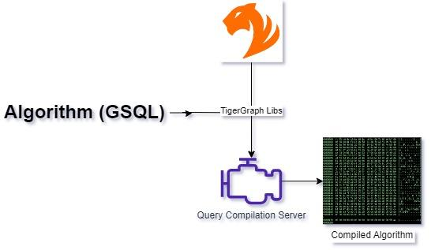
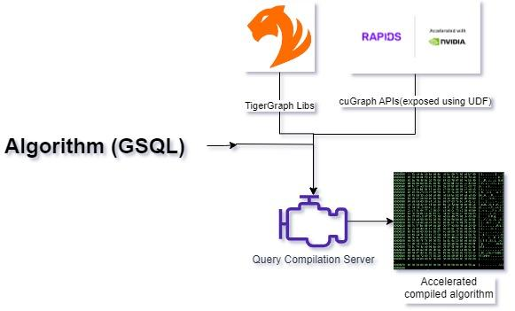
Compilation - Native integration of Rapids with TigerGraph
REGULAR
RAPIDS CAPABLE SYSTEM

Slide 18
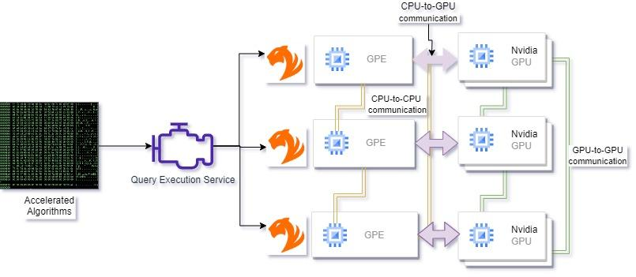
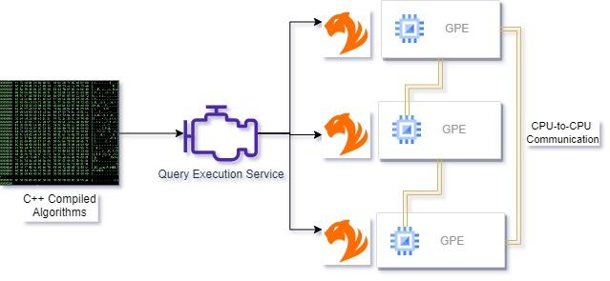
[Execution] Native integration of Rapids with TigerGraph
REGULAR CLUSTER
RAPIDS CAPABLE SYSTEM

Slide 19
Advantages of Next-Gen Architecture
UNPRECEDENTED PERFORMANCE:
SIMPLIFIED SETUP:
SCALABILITY AND FLEXIBILITY:
Leveraging GPU acceleration and streamlined processing pipeline.
Enables rapid execution of complex graph algorithms.
Integration of cuGraph via UDFs into TigerGraph.
Eliminates complex dependencies, reduces configuration overhead.
Dynamic GPU resource management.
Streamlined data transfer mechanisms.
Effortlessly scales to handle large-scale datasets and diverse workloads.

Slide 20



Use a Published Graph Benchmark: LDBC
GRAPH ANALYTICS OVERVIEW:
KEY FEATURES:
PURPOSE:
Developed by the Linked Data Benchmark Council (LDBC).
Comprehensive suite for evaluating graph database management systems and processing frameworks.
Real-world datasets and diverse workloads provided.
Includes a range of graph algorithms for testing system efficiency and scalability.
Helps researchers and organizations assess graph-related technologies.
Facilitates informed decisions in selecting and optimizing graph databases and processing frameworks.

Slide 21
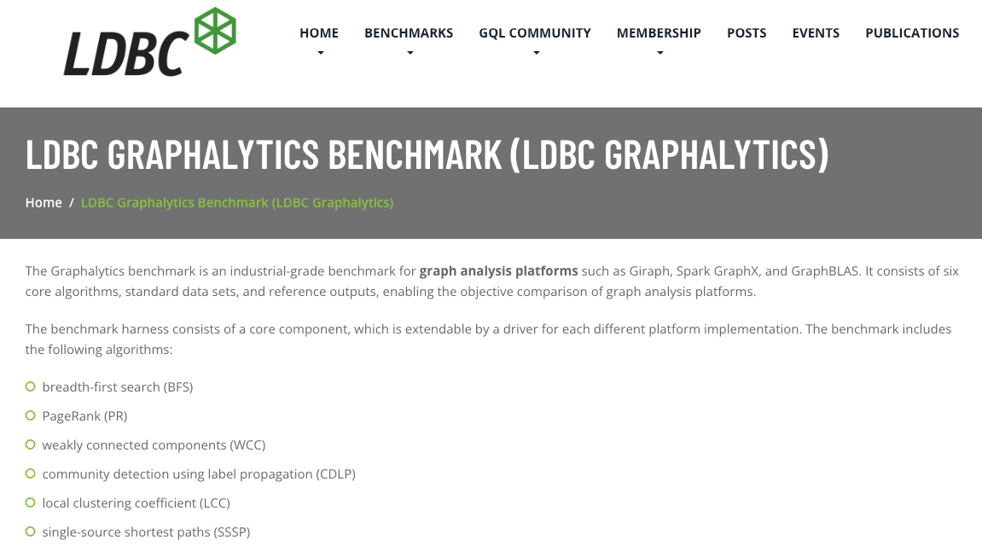
LDBC Graphalytics PageRank Benchmark
PageRank (PR)

Slide 22
PageRank Algorithm Performance
Scale Exponents of 2 | Vertices | Edges | TigerGraph Cluster (Sec) | cuGraph + TigerGraph (python)(Sec) | cuGraph + TigerGraph (Native)(Sec)
Graph 22 | 2.39M​ | 64M | 311.162 | 12.14 (25X) | 6.91 (45X)
Graph 23 | 4.6M​ | 129M | 617.82 | 14.44 (42X) | 9.04 (68X)
Graph 24 | 8.87M | 260M | 1205.34 | 24.63 (48X) | 14.69 (82X)
Graph 25 | 17.06M​ | 523M | 2888.74 | 42.5 (67X) | 21.09 (137X)
Graph 26 | 32.8M​ | 1.05B | 4842.4 | 73.84 (65X) | 41.01 (118X)
Total Nodes | 2 Nodes
Each node has:
RAM | 512G
CPU Cores | 128 Core
A100 GPUs | 4 with 40G RAM each
Connection | UCX
Rapids Version | rapids-23.12
Native cuGraph Integration Shows Nearly 2x Performance Boost Over Python, with Over 100X Improvement in Overall Runtime
Note: This is an end-to-end measure
Over 1 Billion Edges!

Slide 23
Accelerated Graph Processing: 100X+ Speed and 50X Cost Reduction
Instance name | Total Nodes | On-Demand hourly rate($) | vCPU | Memory
m7a.32xlarge | 2 | 7.41888 | 128 | 512 GiB
p4d.24xlarge | 1 | 32.77 | 96 | 1152 GiB
Graph | TigerGraph Cluster (Sec) | cuGraph + TigerGraph (Native)(Sec) | CPU Cost | GPU Cost | Benefit(X)
Graph 22 | 311.162 | 6.91 (45X) | $1.28 | $0.06 | 20
Graph 23 | 617.82 | 9.04 (68X) | $2.55 | $0.08 | 31
Graph 24 | 1205.34 | 14.69 (82X) | $4.97 | $0.13 | 37
Graph 25 | 2888.74 | 21.09 (137X) | $11.91 | $0.19 | 62
Graph 26 | 4842.4 | 41.01 (118X) | $19.96 | $0.37 | 53
GPU Specifications
GPU – A100 | GPU memory
8 | 320 GB HBM2
HBM2 is “High Bandwidth Memory 2”

Slide 24
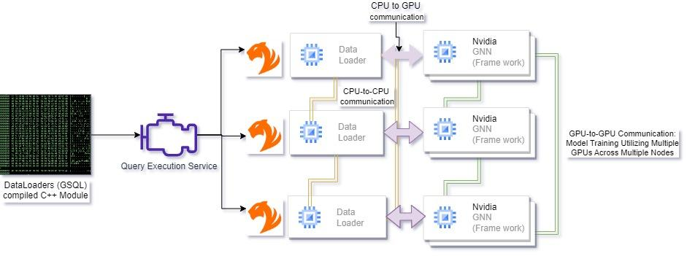
Scaling Accelerated Graph Neural Networks Using the RAPIDS Framework

Slide 25
Summary and Call to Action
By combining TigerGraph and NVIDIA GPUs we can save consumers billions of dollars each year
Visit TigerGraph:
http://tigergraph.com
Connect with Dan McCreary on LinkedIn:
https://www.linkedin.com/in/danmccreary/

